Slide 1
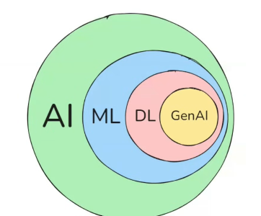

π
Neural Network
Neural network & History
Neural Network –How it works
Component of Neural network
Activation Function
Backward error propagation
Time Series Data
ANN,CNN,RNN
ANN
Neural Network-Layman term
RNN
Type of RNN
Problem with RNN
LSTM
Notes:
Content: https://www.linkedin.com/pulse/chunking-strategies-ai-data-kash-kashyap-0lghe/

Slide 2
1
2
3
Gradient Descent
Loss /Cost Function
Time Series
Relu
TanH
Vanishing Gradient Problem
Learning Rate
Sigmoid
feed forward NN

Slide 3
Regression Analysis
Supervised learning are two types:
Regression
Classification
Categorize anything in one , two or multiple classes
Used to predict continuous numerical values by learning relationships between input variables (features) and an output variable (target).
It helps to understand how changes in one or more factors influence our outcome and
is widely used in forecasting, risk analysis, decision-making and trend estimation
Salary prediction based upon experience
Exam score based on study hours
Car resale price based upon vehicle age

Slide 4
📌
Outliers
outliers are data points that deviate significantly from the general distribution of the dataset points.
♀
These anomalies can appear as surprisingly high or low values, disrupting the distribution of data. These irregular(anomaly) points can shift the distribution, making the data less reliable
﻿For instance, in a dataset of monthly sales figures, if the income for one month are extensively higher than the sales for all of the different months, that high sales determine would be considered an outlier
outliers

Slide 5
Dataset - Bhaut Sare (बहुत सारे - many)
Record
or Observation
or Sample
or Data Point
Same thing different name.
Outlier( unsual )
​Marks: 15, 20, 25, 20, 100
Marks<35 – require extra classes
15+20+25+20+100=180/5=36
Outliers are problematic for model prediction.
Anomaly
Sometimes it is dangerous but sometimes it is useful
अनियमितता
असंगति
Problematic-Employee Avgas salary calculation
Useful –Fraud detection in credit card transaction

Slide 6
There are many types of outliers. That we must trim during our model training
Main Cause of Outlier
Data Entry Error – Simple human error while entering data can create extreme values. Just like age-300
Measurement Error: Faulty device or experimental setup problems can cause abnormally high or low readings.
Intentional Outliers: In some cases, data might be manipulated deliberately to produce outlier effects, often seen in fraud cases.

Slide 7
✿
Linear Regression (find out relation bet x and y)
Linear Regression is a supervised learning algorithm that is used to model(establish) the relationship between a dependent variable and an independent variable.
This algorithm finds the best fit straight line relationship (linear equation) between the two variables. This statistical method is then used to predict the
outcome of future events and is quite useful for predictive analysis.
Suppose you want to determine the salary of a person based on the number of years of work experience they have. What is usually seen is as the number of years of experience increases, their salary increases. Now we can say that:
Here years of experience is the independent variable. It’s a parameter that can be controlled or checked.
The Salary of the person is the dependent variable as its value depends on the years of work experience a person has.
The value of the dependent variable is predicted using the value of an independent variable.
Independent
dependent
Y= mX +b
M=slope of line
(How much y changes for a unit change in X)
b=b is intercept (the value of y when x=0)

Slide 8
e.g.
Presume we need to find annual sell of company.
Thousand of factors that affect out company annual sell.
So annual sell depends upon many factors .So annual sell is dependent variable
All factor that affect annual sell is called independent variable

Slide 9
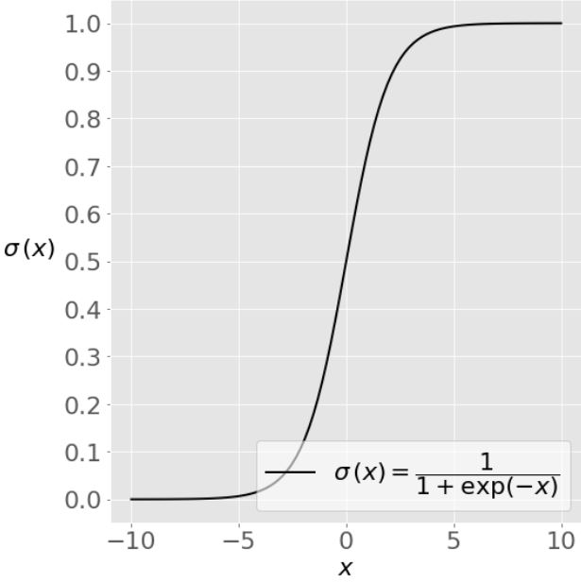
✿
Logistic Regression
It is used when our dependent variable is binary.
It just means a variable that has only 2 outputs. For example, A person will survive this accident or not, The student will pass this exam or not. The outcome can either be yes or no (2 outputs).
Sigmoid function has values very close to either 0 or 1 across most of its domain. This fact makes it suitable for application in classification methods.

Slide 10
What are the applications of logistic regression?
Manufacturing
Manufacturing companies use logistic regression analysis to estimate the probability of part failure in machinery. They then plan maintenance schedules based on this estimate to minimize future failures.
Healthcare
Medical researchers plan preventive care and treatment by predicting the likelihood of disease in patients. They use logistic regression models to compare the impact of family history or genes on diseases.
Finance
Financial companies have to analyze financial transactions for fraud and assess loan applications and insurance applications for risk. These problems are suitable for a logistic regression model because they have discrete outcomes, like high risk or low risk and fraudulent or not fraudulent.
Marketing
Online advertising tools use the logistic regression model to predict if users will click on an advertisement. As a result, marketers can analyze user responses to different words and images and create high-performing advertisements with which customers will engage.

